Slide 1
State of Art* NLP
with HuggingFace
by Yasen Kiprov
*with a few months delay

Slide 2
About me
12 years of experience, dev, entrepreneur, PhD candidate, freelancer, datathon winner
R&D team lead in NLP @SiteGround
Interests: Sentiment analysis, named entity recognition, question answering, dialogue systems
I like simple and effective solutions

Slide 3

Quick Ad
Regular meetups on Data Science and Python
Usually free beer
Recently online and recorded
Looking for speakers

Slide 4
Agenda
Background on transformer neural networks
Encoder - Decoder
Attention
Bert
Introduction to HuggingFace transformers library
Models and tokenizers
Pipelines
Hands-on
Ex 1: Run a model
Ex 2: Run a model as a pro
Ex 3: Fine-tune a pretrained model

Slide 5
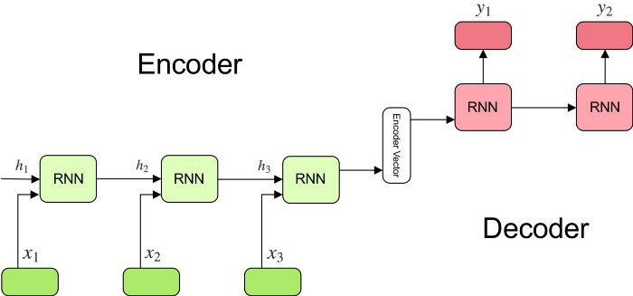
Encoder - Decoder architecture
Encoder - reads the input
Decoder - generates the output
Useful for:
Machine translation
Text Summarization
Named Entity Recognition
Speech to Text
https://towardsdatascience.com/understanding-encoder-decoder-sequence-to-sequence-model-679e04af4346

Slide 6
Encoder - ? architecture
Encoder - reads the input
A custom NN uses the encoder vector
Useful for:
Text Classification
Anything
Custom Layers
https://towardsdatascience.com/understanding-encoder-decoder-sequence-to-sequence-model-679e04af4346

Slide 7
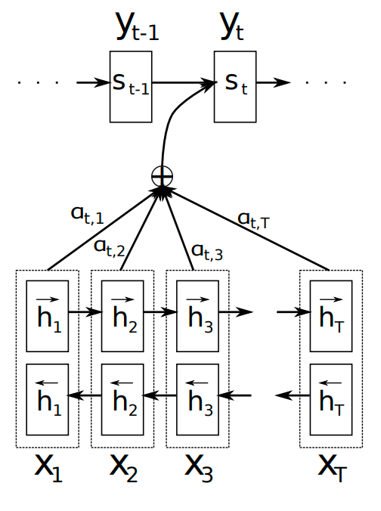
NLP Current State of Art
Attention is all you need! Vaswani et al 2017
Representations of all inputs participate on each output step
No bottleneck in one representation vector
No time decay of early inputs
Bonus: Computation parallelization (faster training)

Slide 8
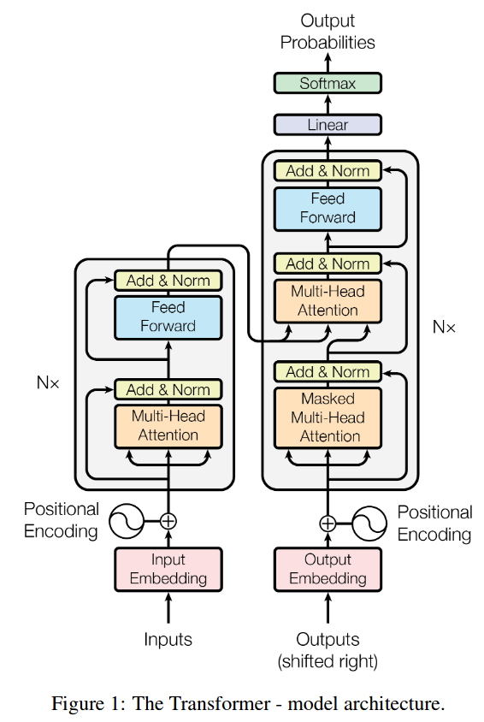
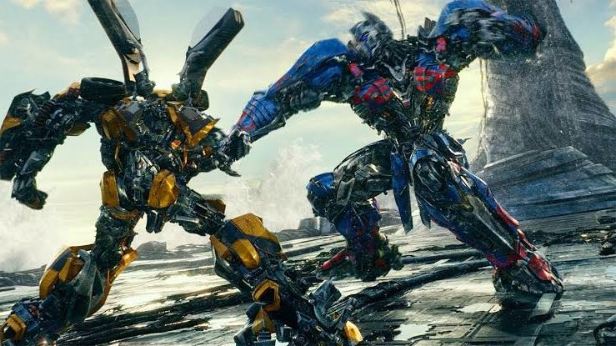
Transformer
Attention-only based encoder-decoder network

Slide 9
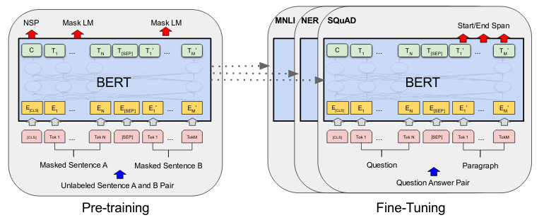
Bert
The same transformer, new tasks
Pre-training of Deep Bidirectional Transformers for Language Understanding (Devlin et. al, 2019)

Slide 10
Bert
Ground-breaking pre-training:
Masked language model
Next sentence prediction
Huge amounts of unlabeled data
“Special” CLS tokens - used to attach a NN for classification
Fine-tuning on many tasks
State of art on most of them

Slide 11
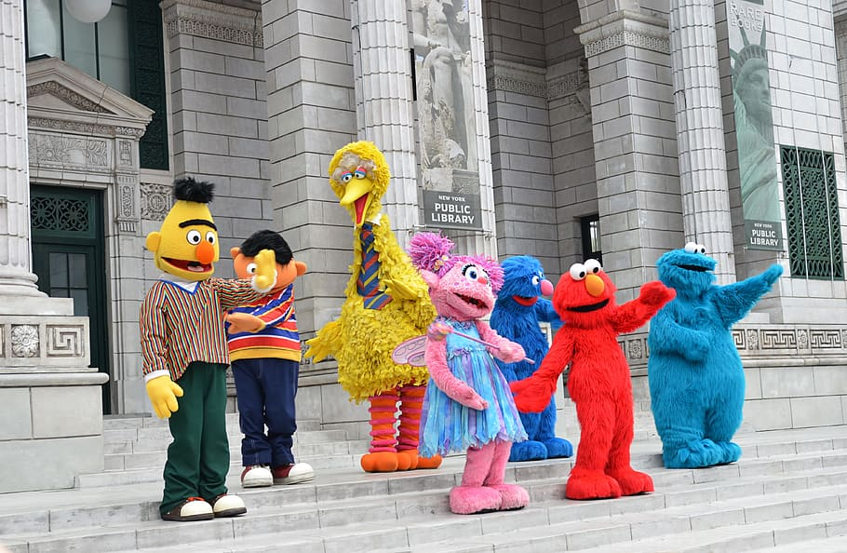
The Bert Family
RoBerta
Distilbert, Albert, StructBert
Ernie
GPT-2, T5, Pegasus
Reformer
Key: Massive pre-training & optimisations
Result: near-human performance
TODO: show Glue benchmark

Slide 12
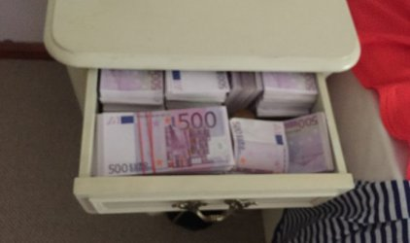
Size and cost of training
Bert: 350M parameters, three days on 16 TPUv3 chips
“It costs $245,000 to train the XLNet model … 512 TPU v3 chips * 2.5 days”
T5: 11B parameters: “[we] train models on “slices” of Cloud TPU Pods.TPU pods are multi-rack ML supercomputers that contain 1,024TPU v3 chips”
GPT-3: 175B parameters: “... memory requirement exceeding 350GB and training costs exceeding $12 million”

Slide 13

HuggingFace
A company, focused on solving NLP tasks
Transformers: a community-driven OS library for NLP
Provides a simple interface and great docs
Pre-trained models for many state-of-art NLP systems
Implementations in PyTorch and Tensorflow 2
Good for out-of-domain researchers

Slide 14
HuggingFace Philosophy
Keep it simple - common interface to all architectures
Ready-to-use pre-trained models + lots of community built models
Easy to fine-tune on custom data
Production ready
Not for editing and implementing your own networks

Slide 15
HuggingFace Tasks
Sentence Classification
Token (sequence) Classification
Extractive Question Answering
Language Modeling
Named Entity Recognition
Summarization
Translation
Etc.

Slide 16
HuggingFace Main Concepts
Model (Bert, GPT-2, etc.): NN architectures in PyTorch (torch.nn.Module)
Configuration: store all the extra parameters required to train a model
Tokenizer: store the vocabulary for each model and provide methods for encoding/decoding strings in a list of token embeddings indices to be fed to a model
from_pretrained(): load any pretrained model or tokenizer by name
AutoModel: a factory class which knows what model class to use, by name

Slide 17
Pipelines
A wrapper function, which handles:
Tokenization and input encoding
Running the model
Decoding the output to useful format
Oversimplification, down to a single line of code.

Slide 18
Side note: Colab
https://colab.research.google.com/
Google Colaboratory - needs to be installed in Google Drive
Jupyter notebooks, hosted by Google online
Great for experimenting, lots of
Free ram, disk space, (occasionally) access to GPUs
Downside: reset sessions if inactive for a few hours

Slide 19
Exercises
Ex 1: Run cool models with pipelines
Ex 2: Run a model in the standard HuggingFace way
NOTE: Еxercises are almost directly copied from HuggingFace examples page

Slide 20
Resources
https://huggingface.co/models - all available models
https://arxiv.org/abs/1706.03762 - “Attention is All You Need”
https://arxiv.org/abs/1810.04805 - “Bert” paper
https://machinelearningmastery.com/global-attention-for-encoder-decoder-recurrent-neural-networks/ - Introduction to Attention
https://huggingface.co/gpt2?text=My+name+is+Yasen+and+I+like+to : live demos of some models

